Slide 1

Major Project First Review Presentation on
NeuroSense : Multimodal Autism Spectrum Disorder Screening System
SIDDAGANGA INSTITUTE OF TECHNOLOGY, TUMKUR
Department of Information Science and Engineering
Under the guidance of
Mrs. Rajarajeshwari
Assistant Professor
Dept. of ISE, SIT, Tumakuru
By
Suman Bhat [1SI23IS108]
Vaibhav J P [1SI23IS117]
Vrushank G [1SI23IS126]
Y Darshan [1SI23IS127]

Slide 2
OUTLINE
Outline
Introduction
Problem statement
Objectives
Literature Survey
Proposed work
System Architecture
Requirements
Application
Conclusion
References
2
Dept. of ISE, SIT, Tumkur

Slide 3
INTRODUCTION
Introduction
Autism Spectrum Disorder (ASD) affects communication, behavior, and social interaction
Early detection is difficult due to reliance on manual and subjective methods.
Limited availability of specialists leads to delayed diagnosis.
AI-based systems can improve early screening using multiple data inputs.
This creates the need for an intelligent and automated screening system
3
Dept. of ISE, SIT, Tumkur

Slide 4
PROBLEM STATEMENT
Problem Statement
Autism Spectrum Disorder is often detected late due to reliance on manual observation, subjective questionnaires, and limited availability of experts. These traditional methods depend heavily on human judgment, which can vary from one evaluator to another. In many regions, lack of awareness and access to trained professionals further delays diagnosis. Existing screening approaches also lack accuracy, consistency, and scalability for large-scale use. Therefore, there is a need for an intelligent, automated, and reliable system that can assist in early ASD screening using multiple behavioural indicators.
4
Dept. of ISE, SIT, Tumkur

Slide 5
Problem Statement
OBJECTIVES
To develop an AI-based system for early screening of Autism Spectrum Disorder.
To analyse behavioural questionnaire data using machine learning techniques.
To detect facial expression patterns using deep learning models.
To track eye gaze behaviour for identifying attention-related patterns.
To analyse speech signals for detecting communication irregularities.
To integrate multiple data sources using a multimodal fusion approach.
5
Dept. of ISE, SIT, Tumkur

Slide 6
LITERATURE SURVEY
Literature Survey
Ref. No | Title | Author, Year | Methodology | Key findings | Relevance to Projects
01. | Machine Learning for Autism Detection | Thabtah, 2019 | Applied classification algorithms on ASD screening datasets. | ML models can accurately classify ASD based on behavioral features. | Forms base for questionnaire-based prediction module.
02. | Autism Screening Using Data Mining Techniques | Duda et al., 2016 | Used feature selection and classification models for ASD detection. | Reduced number of features while maintaining high accuracy. | Helps in optimizing input features for faster prediction.
03. | Facial Expression Recognition in Autism | Hashemi et al., 2018 | Used CNN models to analyze facial expressions. | ASD individuals show distinct facial expression patterns. | Supports facial analysis module in system.
04. | Eye Gaze Tracking in Autism Studies | Jones & Klin, 2013 | Eye-tracking experiments on children with ASD. | Reduced eye contact is a strong ASD indicator. | Basis for gaze tracking component.
6
Dept. of ISE, SIT, Tumkur

Slide 7
LITERATURE SURVEY
Literature Survey
Ref No | Title | Author, Year | Methodology | Key Findings | Relevance to project
05. | Speech Analysis for Autism Detection | Bone et al., 2014 | Extracted acoustic features from speech signals. | ASD speech shows differences in pitch and rhythm. | Used for speech-based prediction module.
06. | Multimodal Machine Learning for Healthcare | Baltrusaitis et al., 2019 | Combined multiple data modalities using fusion models. | Multimodal systems improve prediction accuracy. | Core idea for combining multiple ASD indicators.
07. | Explainable AI in Healthcare | Ribeiro et al., 2016 | Introduced LIME for model interpretability. | Improves transparency and trust in AI systems. | Used for explainable ASD predictions.
08. | Deep Learning for Behavioral Analysis | Goodfellow et al., 2016 | Applied deep neural networks for pattern recognition. | DL models perform well in complex behavioral analysis. | Supports deep learning modules in system.
7
Dept. of ISE, SIT, Tumkur

Slide 8
OUTCOME OF THE LITERATURE SURVEY
Literature Survey
Machine learning techniques can effectively detect ASD using behavioural data
Facial expression and eye gaze analysis provide important non-verbal indicators.
Speech patterns help in identifying communication-related differences.
Multimodal approaches improve accuracy compared to single-model systems.
Most existing systems lack proper explainability and transparency.
Hence, there is a need for an integrated, accurate, and explainable multimodal ASD detection system.
8
Dept. of ISE, SIT, Tumkur

Slide 9
PROPOSED WORK
Proposed Work
NeuroSense AI is a multimodal ASD screening system designed to overcome limitations of traditional methods such as subjectivity and delayed diagnosis.
The system uses AI techniques including machine learning, deep learning, computer vision, and speech analysis to enable early and reliable screening.
It analyses multiple inputs like questionnaire responses, facial expressions, eye gaze, and speech patterns to improve accuracy and consistency.
9
Dept. of ISE, SIT, Tumkur

Slide 10
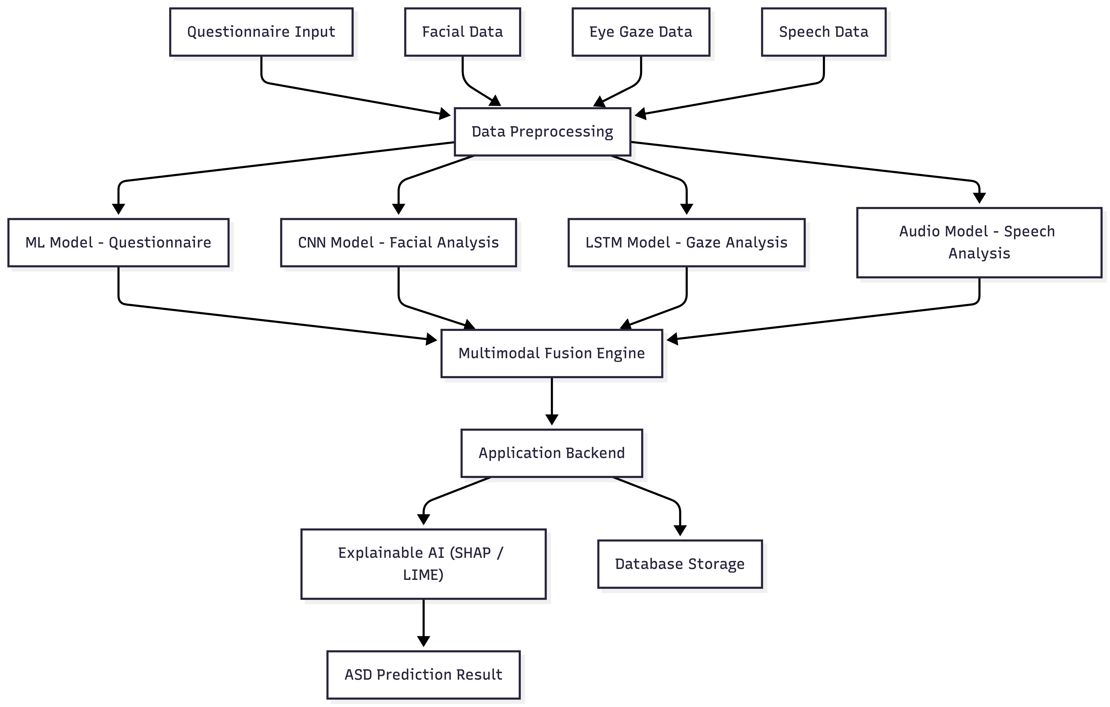
System Architecture

Slide 11
Requirements to Develop the Project
Hardware Requirements
Webcam for capturing facial expressions
Microphone for recording speech data
Computer/Laptop with good processing capability
GPU for training deep learning models
Software Requirements
Frontend: React.js for building user interface
Backend: FastAPI for API development
Database: MongoDB for storing user data
Machine Learning: XGBoost
Computer Vision: OpenCV
Explainable AI: SHAP, LIME
17
Dept. of ISE, SIT, Tumkur

Slide 12
APPLICATIONS
Applications
Early Autism Screening
Enables early identification of ASD risk in children using AI-based analysis.
Clinical Decision Support
Assists doctors and psychologists in preliminary ASD assessment.
Educational Support Systems
Helps schools identify students who need special learning support.
Remote Screening and Telemedicine
Allows ASD screening in remote areas without the need for specialists.
Parental Awareness and Monitoring
Provides insights to parents about behavioral patterns and early signs.
Research and Behavioral Analysis
Supports researchers in studying ASD-related behavioral data and trends.
18
Dept. of ISE, SIT, Tumkur

Slide 13
CONCLUSION
Conclusion
NeuroSense presents an intelligent approach for early screening of Autism Spectrum Disorder.
The system combines questionnaire data, facial analysis, gaze tracking, and speech analysis for better accuracy.
Multimodal integration improves reliability compared to traditional single-method screening.
Explainable AI provides clear insights into how predictions are made.
The system is scalable, user-friendly, and suitable for real-world applications.
It can support early detection, enabling timely intervention and better outcomes.
21
Dept. of ISE, SIT, Tumkur

Slide 14
REFERENCES
References
[1] F. Thabtah, “Machine Learning for Autism Spectrum Disorder Detection,” 2019.
[2] M. Duda, R. Ma, N. Haber, and D. Wall, “Use of Machine Learning for Behavioral ASD Screening,” 2016.
[3] M. Hashemi et al., “Facial Expression Recognition in Children with Autism Using Deep Learning,” 2018.
[4] W. Jones and A. Klin, “Attention to Eyes is Present but Declines in Autism,” 2013.
[5] D. Bone et al., “Use of Speech Patterns for Autism Detection,” 2014.
[6] T. Baltrušaitis, C. Ahuja, and L. Morency, “Multimodal Machine Learning: A Survey,” 2019.
[7] M. T. Ribeiro, S. Singh, and C. Guestrin, “Why Should I Trust You? Explaining Predictions using LIME,” 2016.
[8] I. Goodfellow, Y. Bengio, and A. Courville, “Deep Learning,” MIT Press, 2016.
22
Dept. of ISE, SIT, Tumkur

